Slide 1

WATER LEVEL INDICATOR

Slide 2

OBJECTIVE
Address the control of water wastage wireless information regarding level of water
Home automation web based water level monitoring and controlling system

Slide 3

COMPONENTS USED
Arduino UNO
Arduino Uno is an opensource microcontroller board based on the Microchip ATmega328P microcontroller
Water Level Sensor
A water level sensor (AKA fluid or liquid level sensor) detects and measures the amount of liquid in a container, tank, or area.
LEDs
LED, in full light-emitting diode, in electronics, a semiconductor device that emits infrared or visible light when charged with an electric current.
Piezo Buzzer
Buzzers are electric sounding devices that generate sounds. Typically powered by DC voltage, they can be categorized as Piezo buzzer and magnetic buzzer.
Resistor
A passive electrical component with two terminals that are used for either limiting or regulating the flow of electric current in electrical circuits.

Slide 4


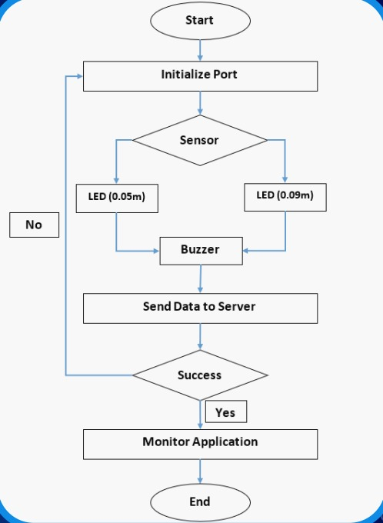
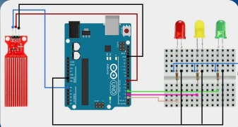
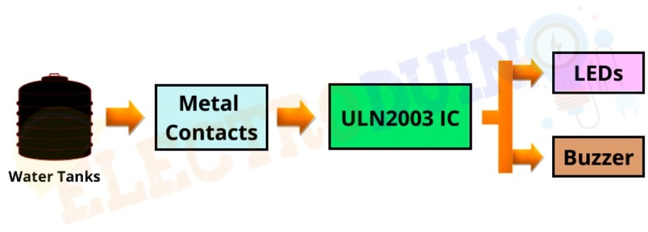
BLOCK DIAGRAM TO EXPLAIN THE WORKING

Slide 5
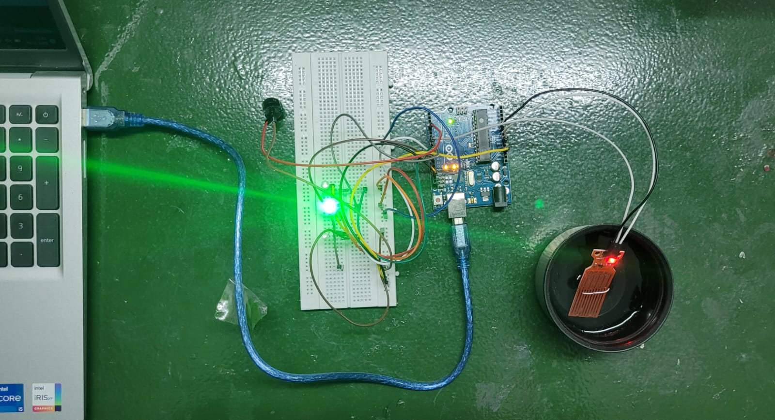
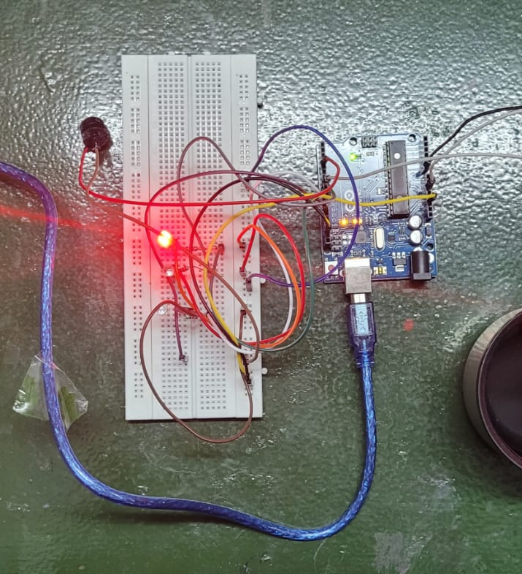
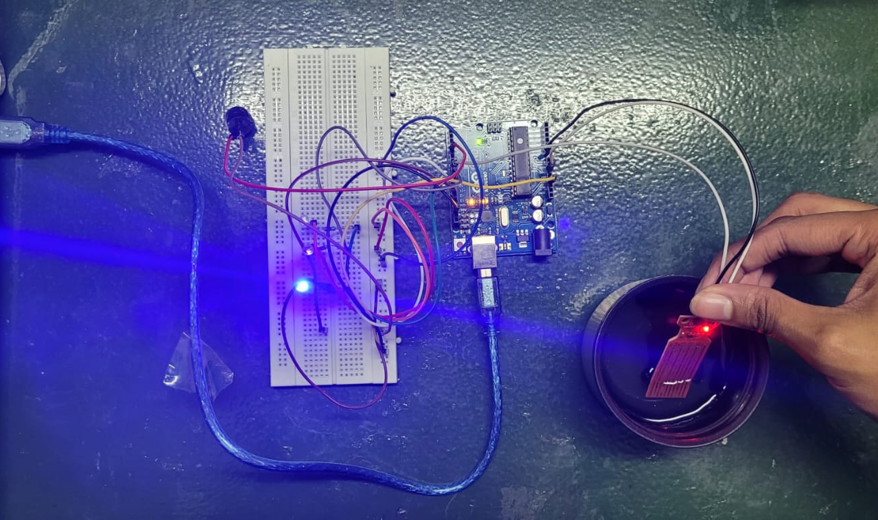
PHOTOS OF THE WORKING MODEL

Slide 6

RESULTS
When the level of the water is low, the red light glows
When the level of the water is reasonable, the yellow light glows
When the level of the water is high, the green light glows
When the level of the water about to overflow, the buzzer will sound.

Slide 7

CONCLUSION
This is a simple model water level indicator which can be made at your home. This project is the solution to help the user to indicate water level in reservoir or into the water tank that indicated different levels in an over-head tank. A connection runs under to the underground tank to check the availability of water in the tank before operation the pump and the pump operates only automatic Water level Controller can be used in Hotels, Factories, Homes Apartments, Commercial Complexes, Drainage, etc., Finally, the project has been successfully implemented & tested.

